Slide 1
Dbms Project
Team: Kongara Anshu(207237)

Slide 2

GameDatabase

Slide 3
Problem Statement
To create a database which contains all the data related to an online “First Person Tactical Shooter(FPS)” game in specific: Tolerant. The stored data includes the current Players, Agents, Servers, Maps, and equipment.

Slide 4
Features of database
This database contains information of all the players that play the game: either currently or registered with it.
Those newly registered will get updated in the database.
Maintains track of the new equipment being added to the game.
Maintains track of new maps and agents being added to the game.

Slide 5
TABLES IN SCHEMA
There are 6 relations in this database:
Players
Weaponry
Weapon Skins
Maps
Servers
Agents

Slide 6
ENtity relationship diagram
Next page has the er diagram for this database…

Slide 7
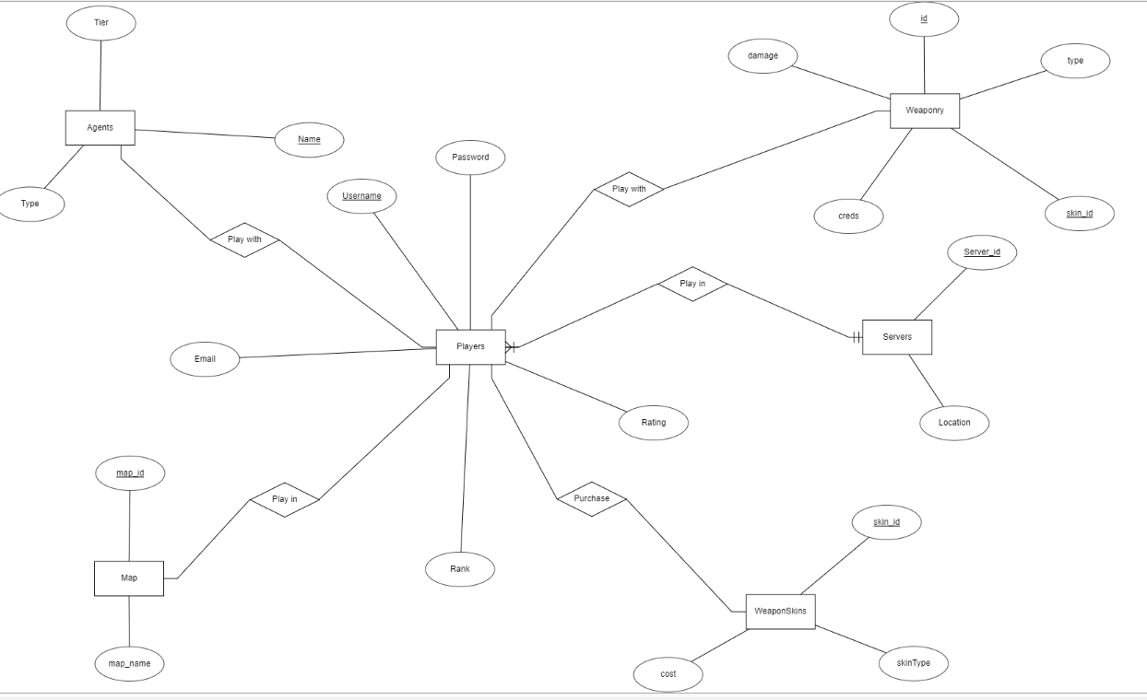
E-R diagram

Slide 8
Entities and entity sets
Players: a relation of all the players in playing the game or registered for it.
It has the following entities: email, username, password, player’s rank, player’s rating. This is in 1NF since all the attributes have single values. Here username is used as primary key since it will be unique to all.
Server: the server on which the player is playing, every server has a unique server_id and a location where the server functions. This is in 2NF.

Slide 9
Entities and entity sets
Maps: these are the areas where players play the games, based on their wins and losses here their rating and rank is affected.
It has two attributes: map_id, map_name
Agents: these are characters that the players play the game with. Every agent is unique. Each agent has the following attribute: type(sentinel/controller/duelist/initiator), name, tier(kind of like a rank based on the agent’s abilities).
Weaponry and weaponSkins: weaponry is the equipment used in-game to play it.
It includes assault rifles, pistols, SMGs etc. and weaponSkins are used to make the user feel better using the guns by giving them new skins etc.

Slide 10
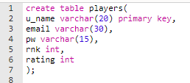

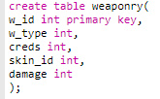



Creation of tables and insertion of data

Slide 11
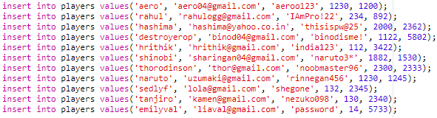
contd…

Slide 12
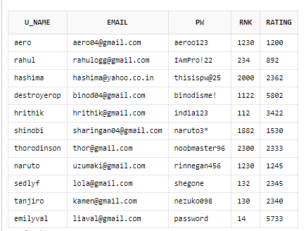
PLAYERS

Slide 13
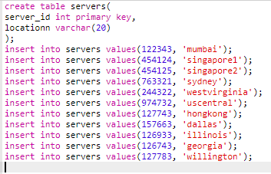
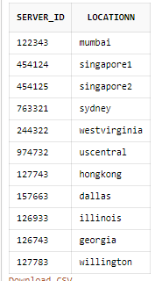
SERVERS

Slide 14
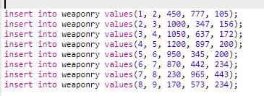
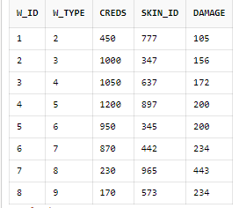
WEAPONRY

Slide 15
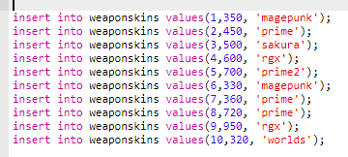
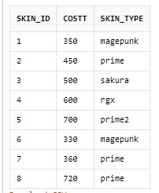
WEAPONSKINS

Slide 16

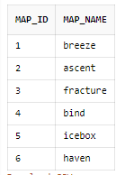
MAPS

Slide 17
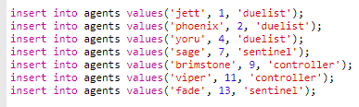
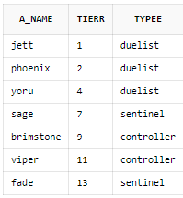
AGENTS

Slide 18
Normalisation
Normalisation is the method of optimising storing information in tables by making more of them or removing unnecessary data. This presence of unnecessary data and its repetiton is called data redundancy. Also due to multiple occurrences of the same data, it makes it difficult to delete and update the records that we want to. So we might end up deleting and updating the information that we don’t really want to and vice versa.

Slide 19
normalisation
All relations except weaponskins are already in optimal normal forms.
In weaponskins, we have the last column having repeated values. This is not in 1NF(has mutlivalues).
This can be resolved by making this relation into two relations: one with skin_id and cost and one with skin id and skin_type

Slide 20
Normalisation contd…
1NF: this occurs when there is atomicity preserved in the relations
2NF: this is when the relation is in 1NF in addition to absence of partial dependency.
3NF: this is when the relation is in 2NF in addition to absence of transitive dependency.
If we observe, our relations are all normalised and are in 1NF, 2NF, 3NF.

Slide 21
Relationships
Play with: since each player can play with any number of number of agents throughout, it is a one to many relationship.
Play in: any number of players can play in any number of servers, so this is a many to many relationship.
Purchase: players purchase the skins they want to play with, this is also a many to many relationship.

Slide 22
Play with: any group of players can play in one map at a time, so this is a many-to-one relationship.

Slide 23
Sources used
Geeks for geeks
ERDPlus
Oracle Live SQL
Google :)

Slide 24
Acknowledgement
I would like to thank our respected Professor Mr.Ramakrishnudu Tene sir for giving us the opportunity to make this project. The process was fun and filled with learning. Also i would like to thank all those who gave advices that aided to improving what i was doing.
This project helped go into depth of some concepts leading to learning new things about the subject.

Slide 25
Thank you!!!
KONGARA ANSHU
207237

